Slide 1
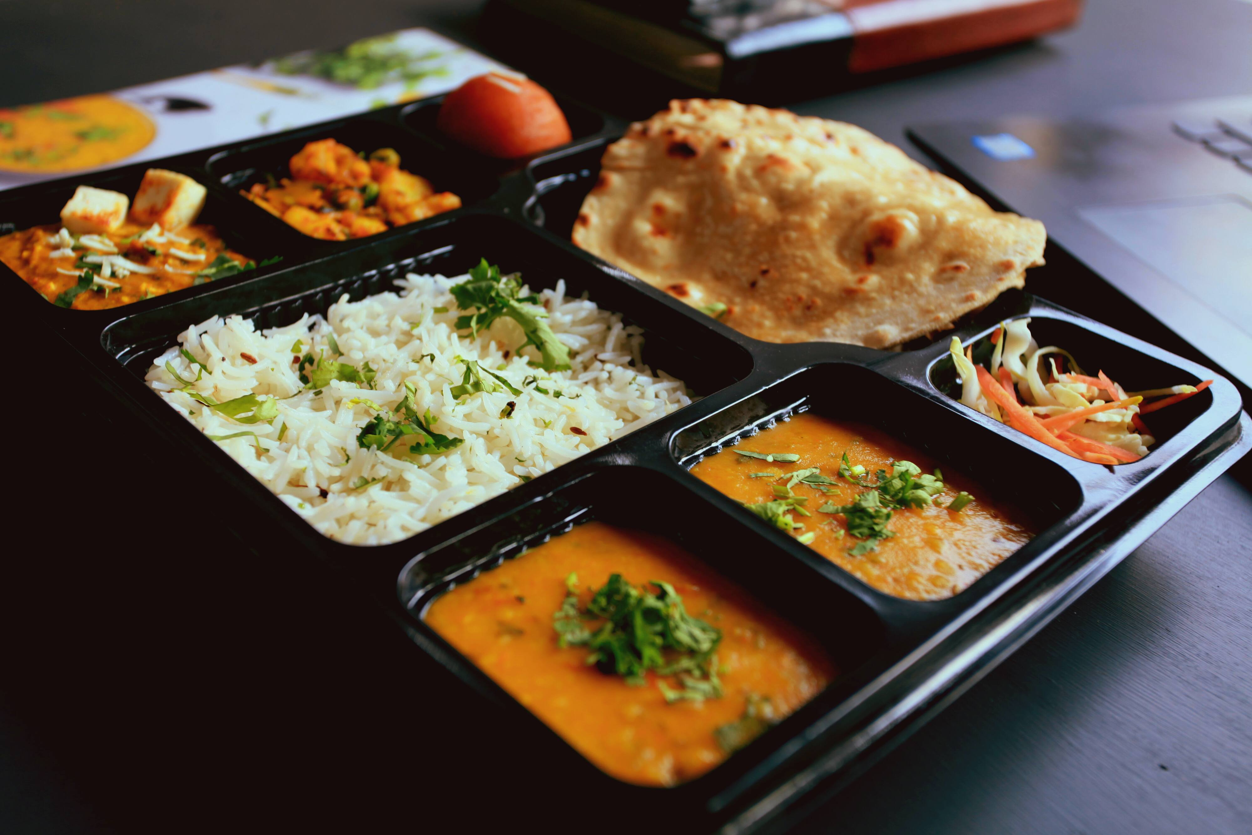
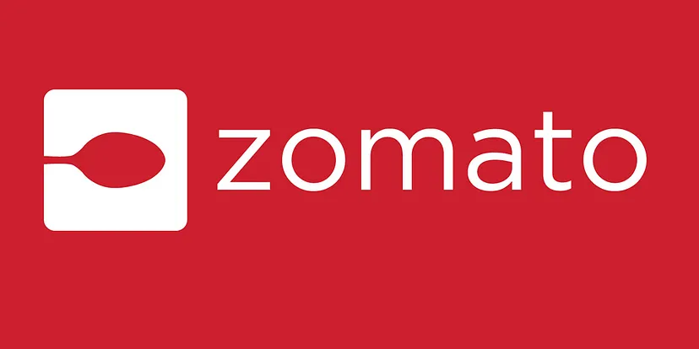
Exploratory Analysis on Zomato Dataset
GROUP- 1

Slide 2
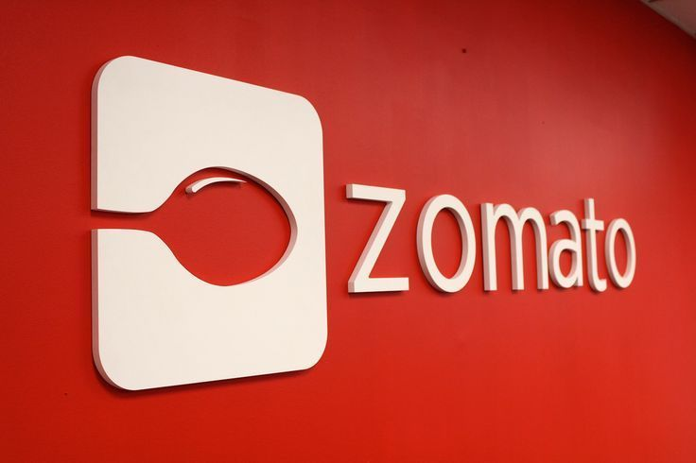
INDEX
01
MEET THE TEAM
02
BUSINESS OVERVIEW
03
BUSINESS PROBLEM
04
DATA TRANSFORMATION
05
DATA MODEL
06
POWER BI DASHBOARD
07
SUGGESTIONS

Slide 3
MEET THE TEAM
Kalyani
Alok Yadav
Pavithra
Gayathri Marimuthu
Mohammed Faijas
Sruthi Pampati
Muhammed sinan s m

Slide 4
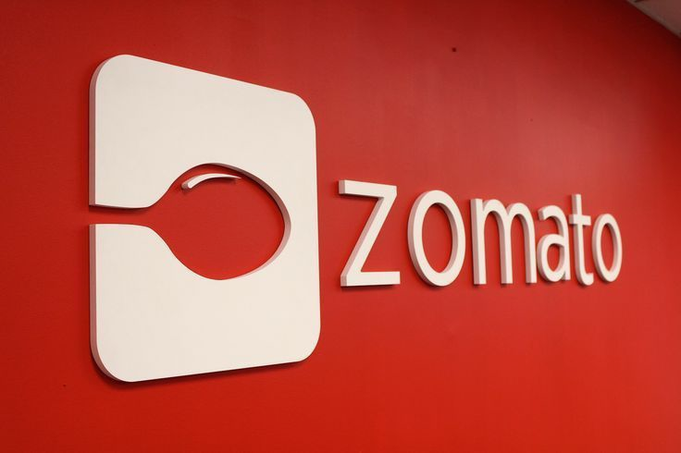
BUSINESS OVERVIEW
Zomato is India’s leading restaurant discovery app. It was started by Deepinder Goyal and Pankaj Chaddah in 2008.
Zomato was started with the name “FOODIEBAY” in 2008 and later renamed as “ZOMATO” in Nov. 2010.
Zomato works as an aggregator between restaurants and foodies. They started with only a food discovery app. Now they have expanded to various macro sections in the food industry.
Zomato Products and Services :-
1. Restaurant Rating and Reviews
2. Restaurant Search and Discovery
3. Online Order :- Food Delivery
4. Pick Up :- Ordering Take away, Table Reservations
5. Gold :- Restaurant Premium and Subscription Services
Online Ordering Service :- Zomato takes a certain percentage from the restaurants on each sale done through the Zomato App.
In-App Advertising :- Advertisement is one of the major contributors to Zomato Revenue.
Delivery Charges :- Zomato also charges a delivery fee from the users. It may depend upon order size and the distance between you and the restaurant.
Organizes Events :- Zomato also started organizing food events with a name zomaland.
Zomato Book and Zomato Pro :- These are 2 services that save a lot of time for the users. With Zomato Book you can reserve any number of sets in any restaurants. And with Zomato Pro gives some additional benefit to the customer with a monthly or yearly fee like buy 1 get 1 on cold drinks, extra discounts, etc.

Slide 5
BUSINESS PROBLEM
Zomato wants to tie up with more restaurants. So, they want to know in which locations they should start providing their services and which type of restaurants they should start approaching .
They also want to know, how they can use the data to convince shopkeepers into accepting their services.
Zomato’s new business client want to set up a restaurant. So, they want to know in which location what category of restaurant they should set up.
And which cuisines at what price they should sell to get good number of customers in future once the restaurant is set.
Moreover, they want to know how Zomato ‘s services can help them in growing their business quickly.
Analyze use ratings and reviews to understand factors to influencing customer satisfaction. Develop strategies to enhance overall restaurant ratings and improve user experience.
Explore the diversity of cuisines offered by Zomato-listed restaurants. Identify popular cuisines and regional variations to align offerings with market preferences.
This project aims to uncover key trends and patterns within Zomato's vast dataset. From exploring the global distribution of restaurants to understanding user preferences and engagement metrics.

Slide 6






BUSINESS PROBLEM
Count the restaurant which has rating more than total average rating
Determine the percentage of restaurants having online delivery
Understand use preferences through ratings and cuisines to improve use engagement and satisfaction
Identify emerging market trends popular cuisines and untapped opportunities to guide Zomato's expansion efforts
Develop data-driven strategies
To expand Zomato presence in regions with low application usage

Slide 7
DATA TRANSFORMATION
​
Handling Missing Values
Replaced Blank Values In cuisines column With NA.
Date
Conversion
Created Date Table From The Date Key-Opening column in main table.
Cleaning
In the Datekey_opening column ‘_’ Replaced with ‘-’.
To Enhance Data Consistency and standardize the date format.
Currency conversion
The standardization of currency by looking up the currency core and converting all local currencies to USD dollars helped us redefined the price range .

Slide 8
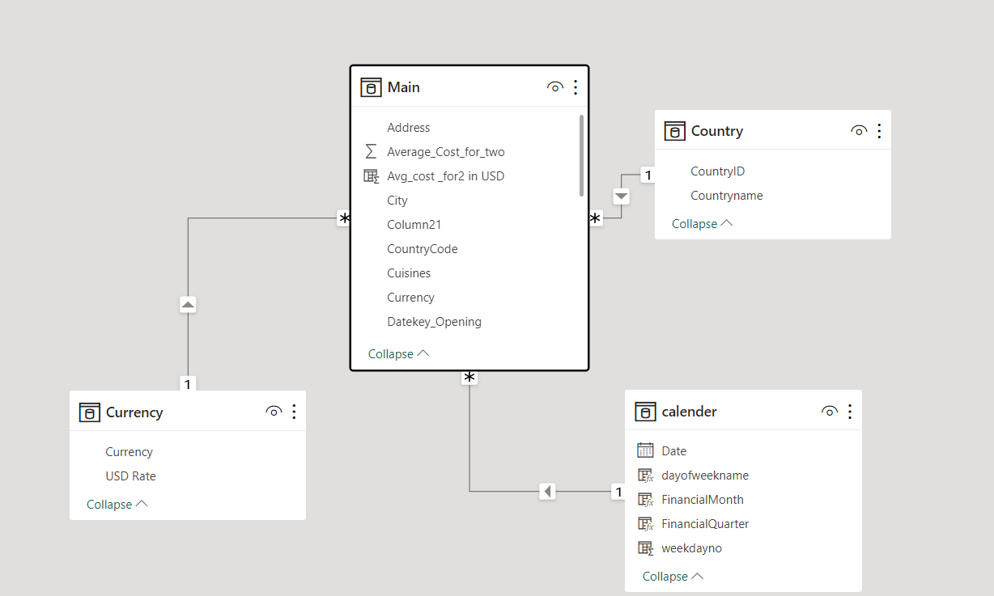
DATA MODEL
​

Slide 9
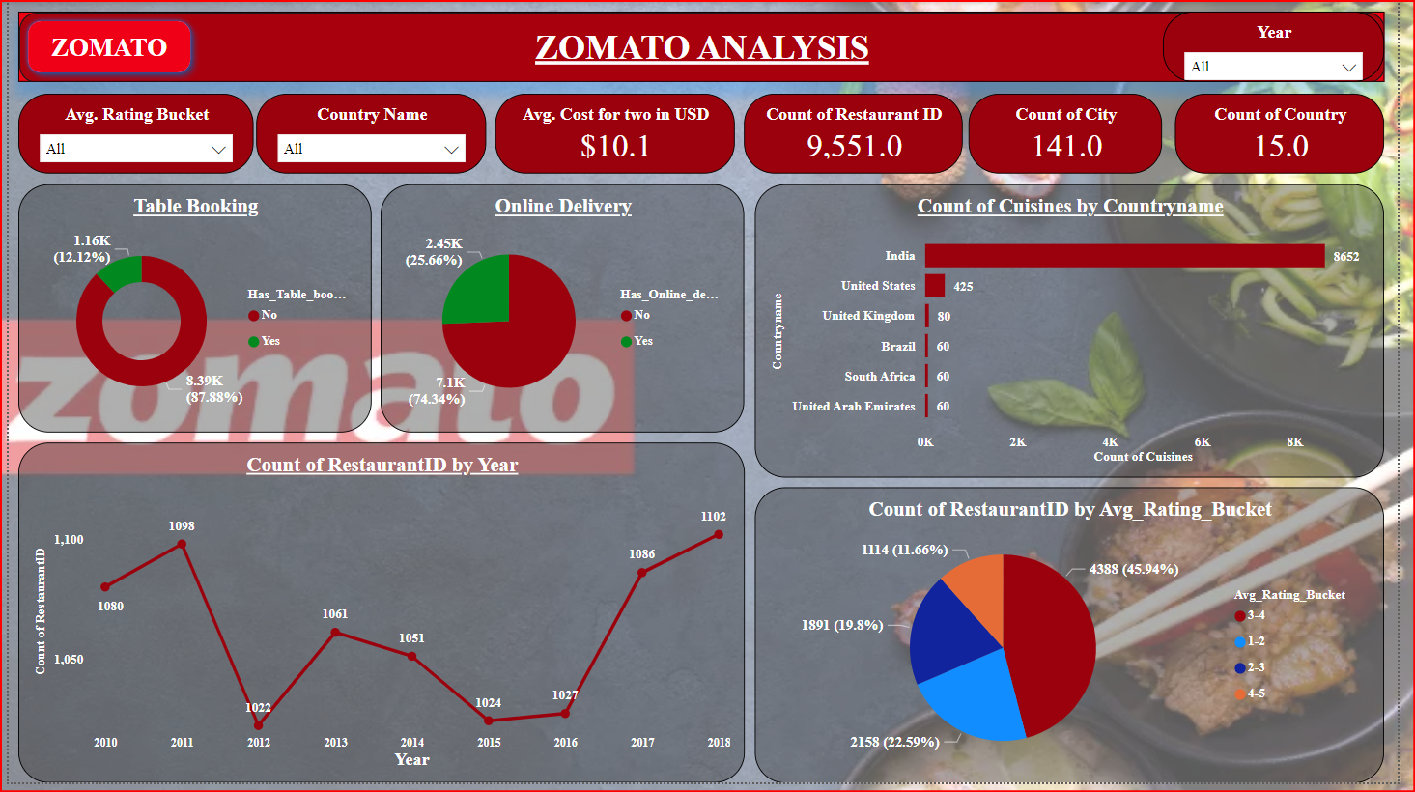
POWER BI DASHBOARD
​

Slide 10
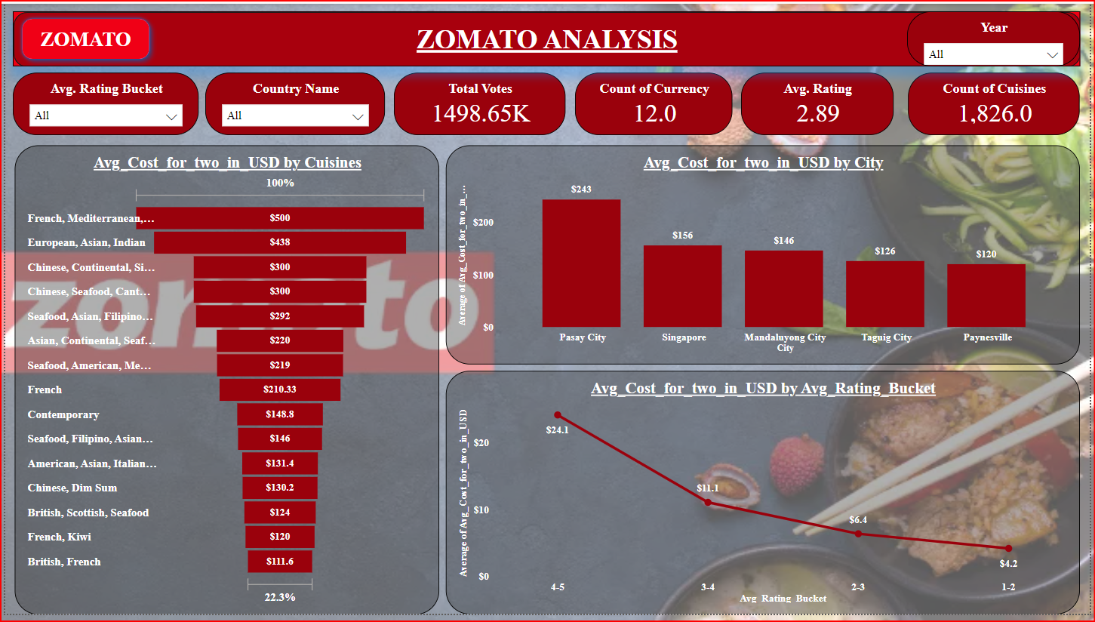
POWER BI DASHBOARD
​

Slide 11
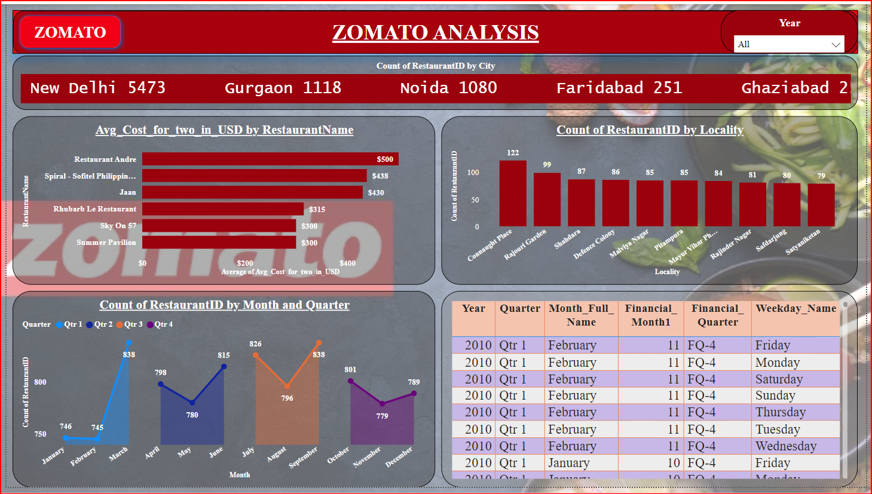
POWER BI DASHBOARD
​

Slide 12
SUGGESTIONS
90% of observations belong to India.
USA (4) has higher ratings than India (3.5) and many Indian restaurants have 0 ratings. Either Zomato should nudge customers to rate, or these are newly onboarded restaurants.
US customers provide ratings more frequently and consistently than Indians.
Popular Indian cuisine is North Indian owing to 4 major North Indian cities and for the USA it’s all-American food.
India and US have moderate food prices as compared to the rest of the countries.
Better affordability has led to restaurants offering in price range 1 but this could affect Zomato’s unit economics. The average price range 1 is Rs 284, except this, all the rest price ranges provide positive returns based on previous analysis on unit economics.
Provide reservations and online delivery to receive valuable customer feedback and rating.
Positive relation exists between ratings and the average cost for two, this could be because of the assumed notion that premium restaurants have good ambiance or better service, whereas regular restaurants cannot provide such an experience which could lead to lower ratings.

Slide 13
SUGGESTIONS
Zomato’s business team can target Locations that have least number of restaurants with book table and online order facility .
Zomato’s marketing team can persuade our new target restaurant owners to use our services for online order facility and Book table facility by letting them know the benefits of it like customer having easier & effective access to their restaurant from home and by giving them an evidence-based assurance of improving their restaurant ratings after using Zomato's services.
We can recommend our new business client to set up his restaurant in places that doesn’t have many restaurants. They can also provide some space within their restaurant where social activities can take place.

Slide 14

NEVER HAVE A BAD MEAL
Acche Din
are finally here!
Order online on
Zomato
Get unbelievable deals from
your favourite restaurants

